Slide 1
Data curation and new visualization tools in GigaDB to promote FAIR and trustworthiness
SiZhe Xiao - Jesse
GigaScience
#CODATA 2019

Slide 2
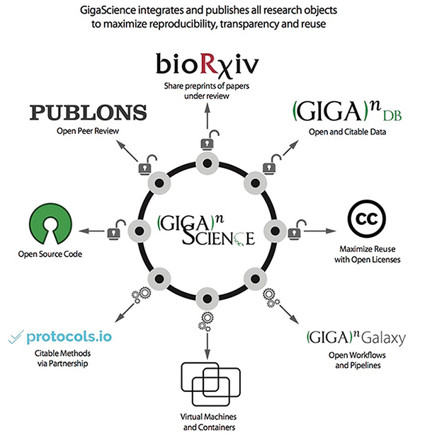


GigaScience
GigaScience is an open access, open data, open peer-review journal focusing on ‘big data’ research from the life and biomedical sciences
Notes:
GigaScience is an open access, open data, open peer-review journal focusing on big data research from the life and biomedical sciences. We are cooperated by BGI and Oxford University Press. Unlike other traditional journals, GigaScience integrates and publishes all research objects to maximize reproducibility, transparency and reuse. The main difference is We publish the dataset which related to the manuscript in our data publishing platform gigadb. also we have some other features e.g share the preprints of papers under review in biorxiv, open workflow and pipline in the gigagalxy, open manuscript peer review in the publons etc.

Slide 3


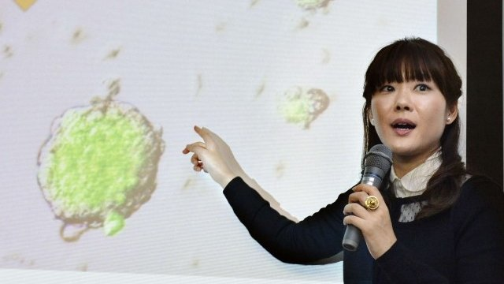
Reasons why research might not be reproducible (excluding fraud, errors, mistakes)
Only summary results shown
Insufficient or unclear methods
Access to software/tools used (inc. proprietary)
Lack of availability of input data (e.g. raw sequences)
…look but don't touch
Notes:
Lots of scientific research results can’t be reproducible prə'praɪət(ə)rɪ

Slide 4

How to combat those issues?
By Data / Transparency review;
Identify and mandate field specific, stable public repositories
Provide hosting for things that don’t have a stable public repository
Guidelines and checklists of what is expected
Provide expert guidance to authors
Notes:
How GigaDB can solve those issues
Identify and mandate field specific and send to the stable public repositories. If the data is sequencing data, will send to INSDC databases, ENA/SRA
Provide hosting for things that don’t have a stable public repository
We provide the detail guideline and checklists for the submitter
Also we have the data curation team to help author to submit data.

Slide 5
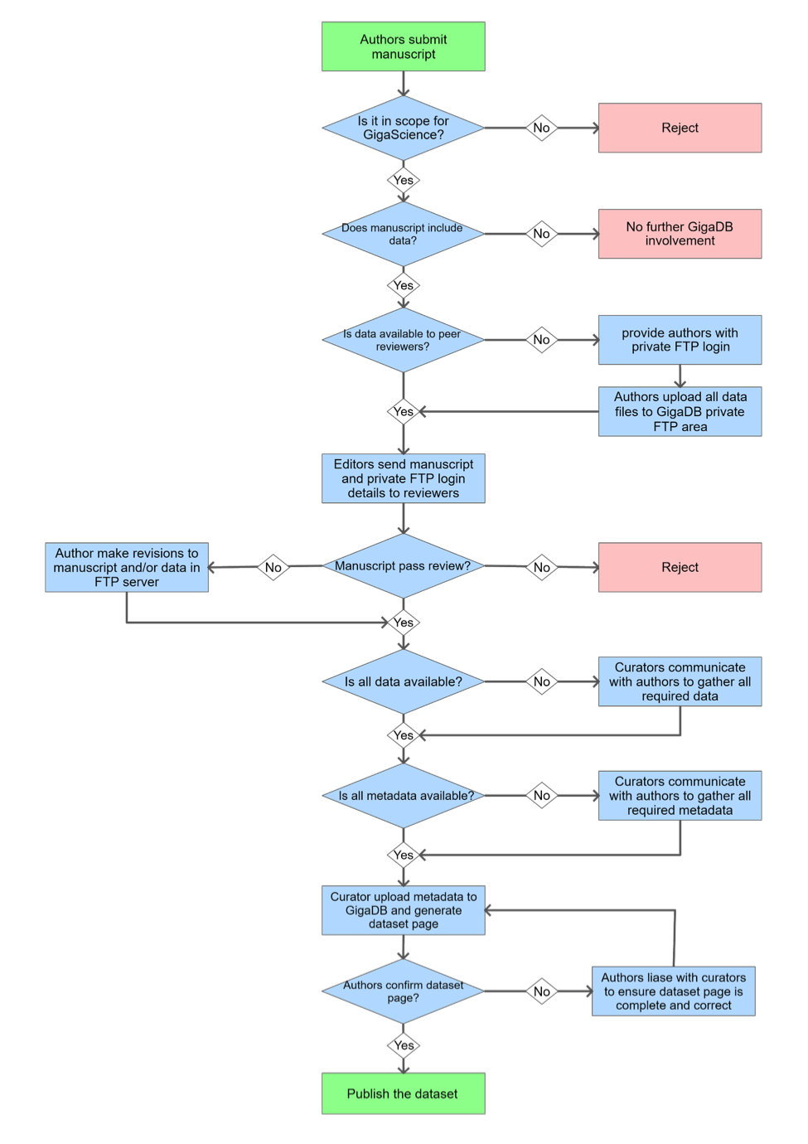
How does the additional work fit into the publishing process?
Initial data availability check to ensure reviewers have access to everything required
Provide authors with private FTP drop-box to upload their data
Curators pull metadata from accepted manuscripts to generate a GigaDB dataset and move data to public FTP area.
http://gigadb.org/site/guide
Notes:
This workflow shows our data publishing services integrate with the journal publication. When author submit the manuscript, at the same time we also ask them submit the dataset related to manuscript.
When manuscipt prepare publish, curators pull metadata from accepted manuscripts to …

Slide 6
Curation
Specialist BioCurators read the methods and results sections to ensure that;
  All the methods are clear and explicit
  All the tools/software/scripts are available somewhere and cited appropriately
  All the input data are available in public stable repositories
  All the results are available in machine readable formats (i.e. not just PDF)
To assist authors, reviewers and biocurators we provide guidelines and checklists to help ensure everyone knows whats expected
http://gigadb.org/site/guide
Notes:
Biocurators in our team will read the methods and results sections to ensure that

Slide 7




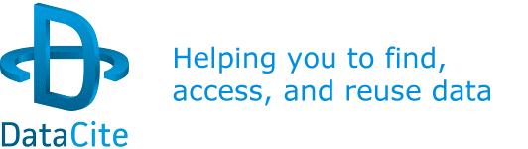


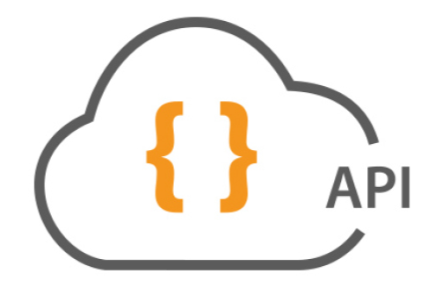


FAIR DATA in GigaDB
Findable
Accessible
Interoperable
Reusable
Notes:
To implement the FAIR principle in GigaDB, we design the functions and works with other service platforms e.g.

Slide 8
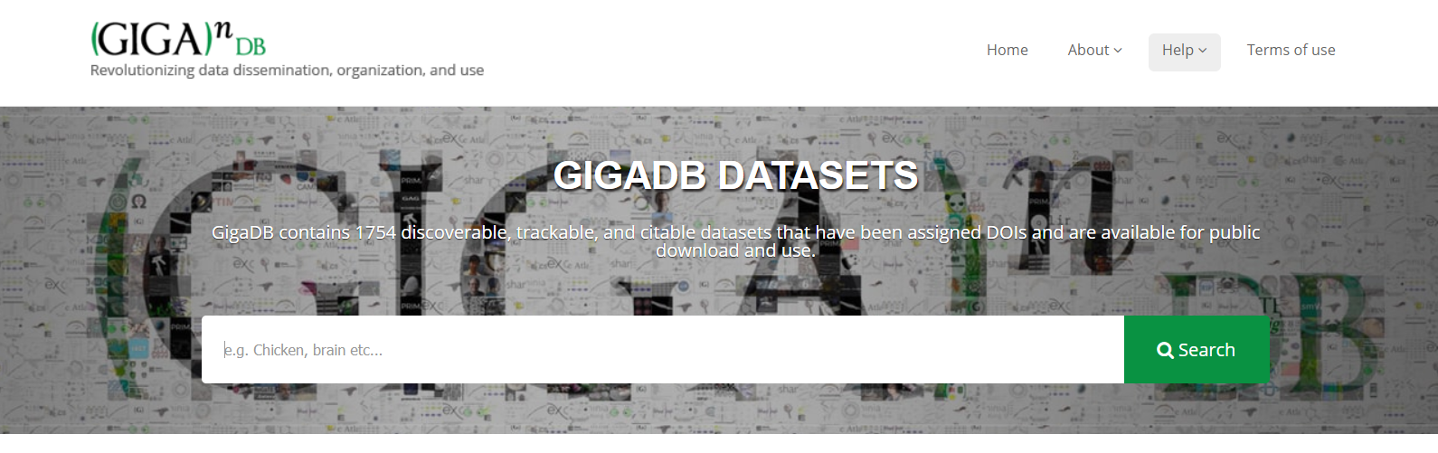
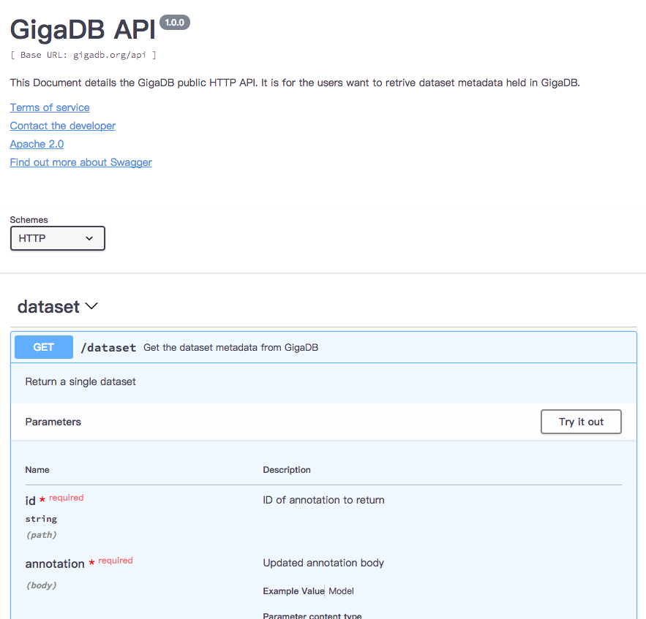

Findable & Accessable
We have 1798 published datasets in GigaDB,
around 44 TB data. Every dataset has the DOI
and the individual dataset page with structured
metadata
All data store at the public AliCloud with
the local storage increamental backup
Provide the powerful search engine
and REST API functions
e.g.
http://gigadb.org/api/search
Notes:
Google schema.org dataset search standard

Slide 9

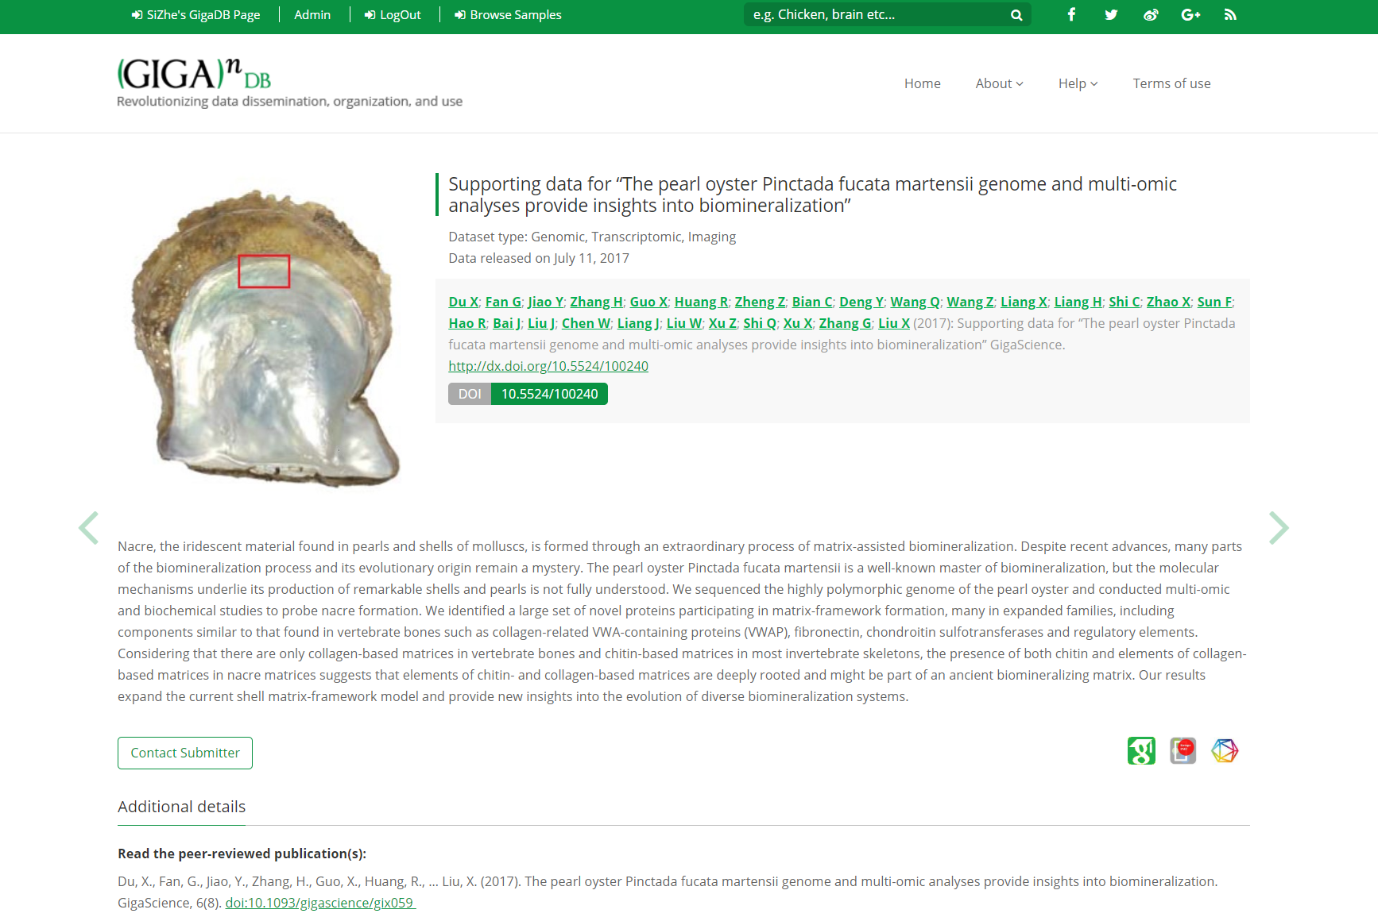

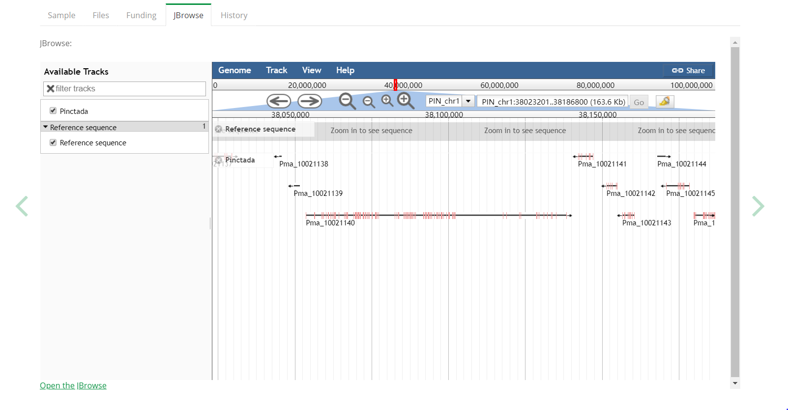
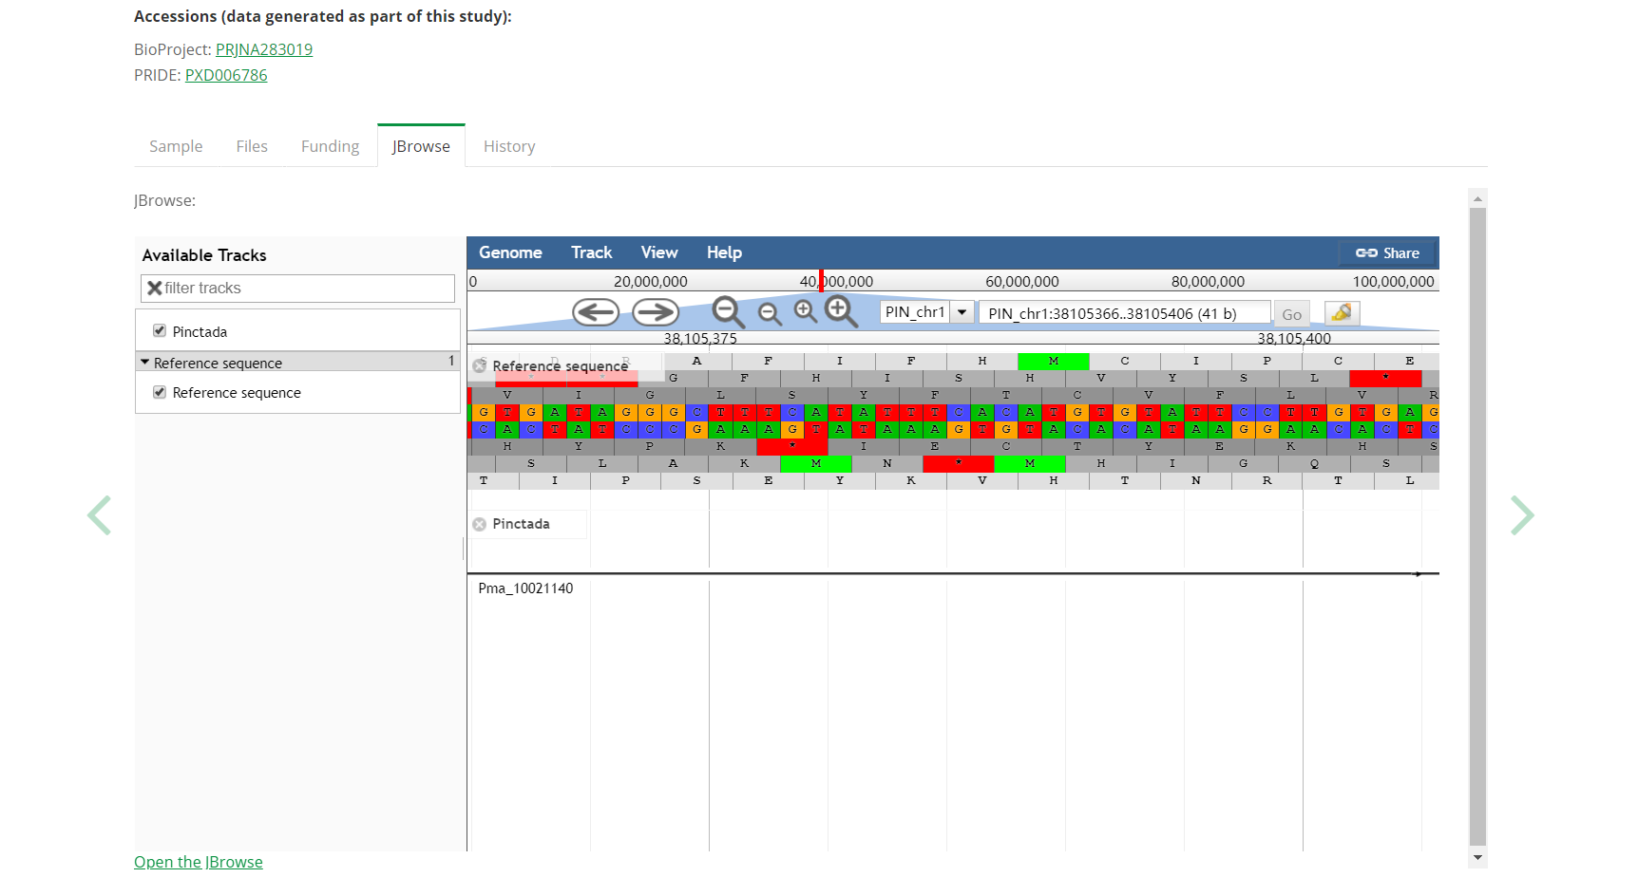
Visualization Tools
Interoperable and reusable
Genomic Dataset
Notes:
Annotation, Variant, CDS

Slide 10
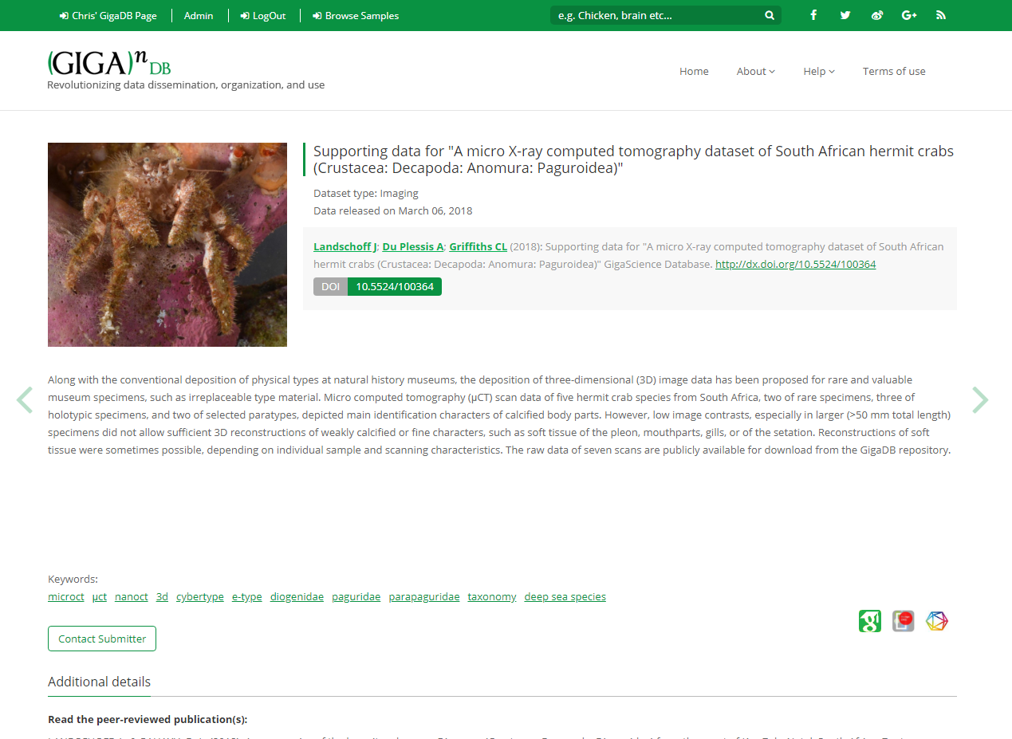
imaging dataset
Notes:
For the image dataset, like this one Micro-CT image for SouthAfrican hermit crab dataset, we published last year. On the dataset page

Slide 11
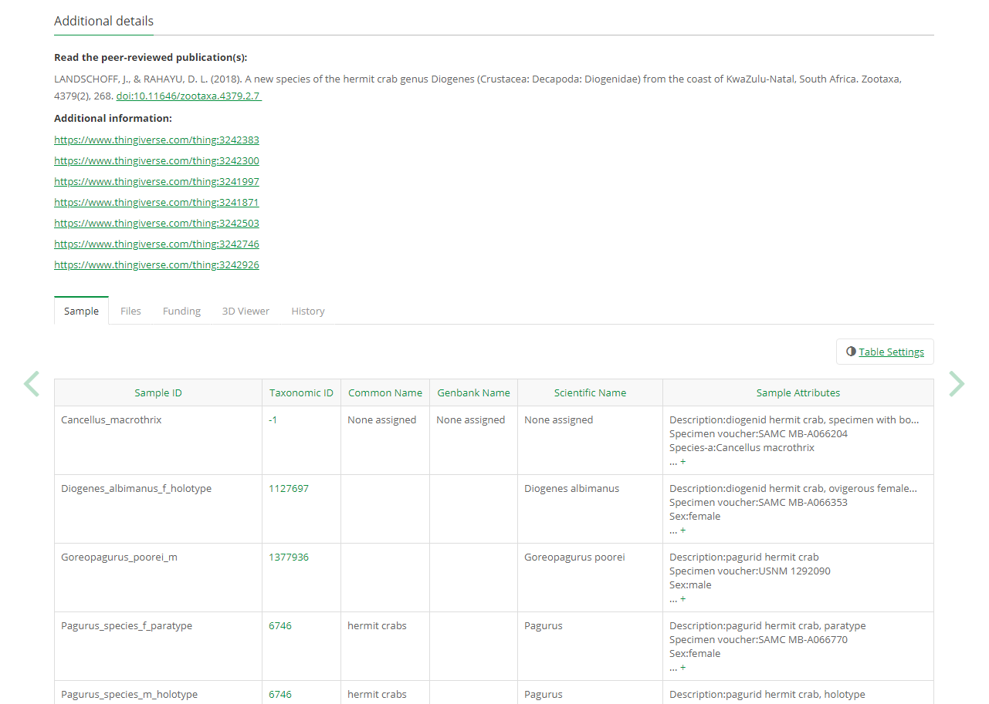

Slide 12
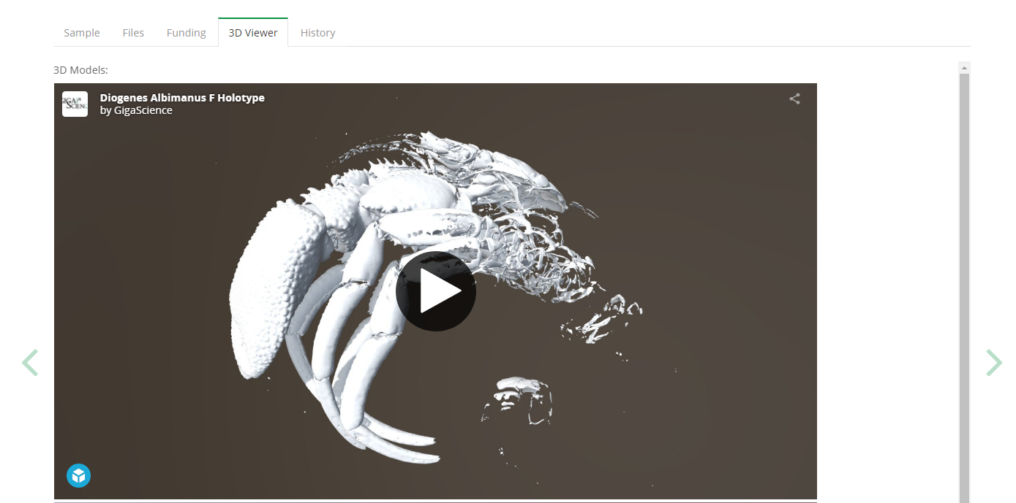
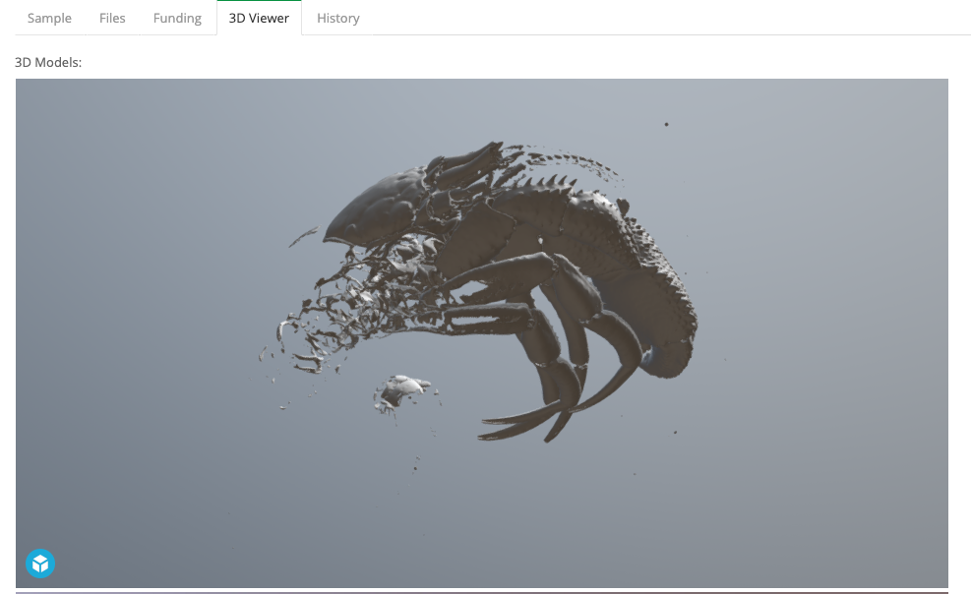
3D viewer tab
Notes:
Here we embed the sketchfab widget, that can display the 3d models on the gigadb dataset page, user can directly play this image model.

Slide 13
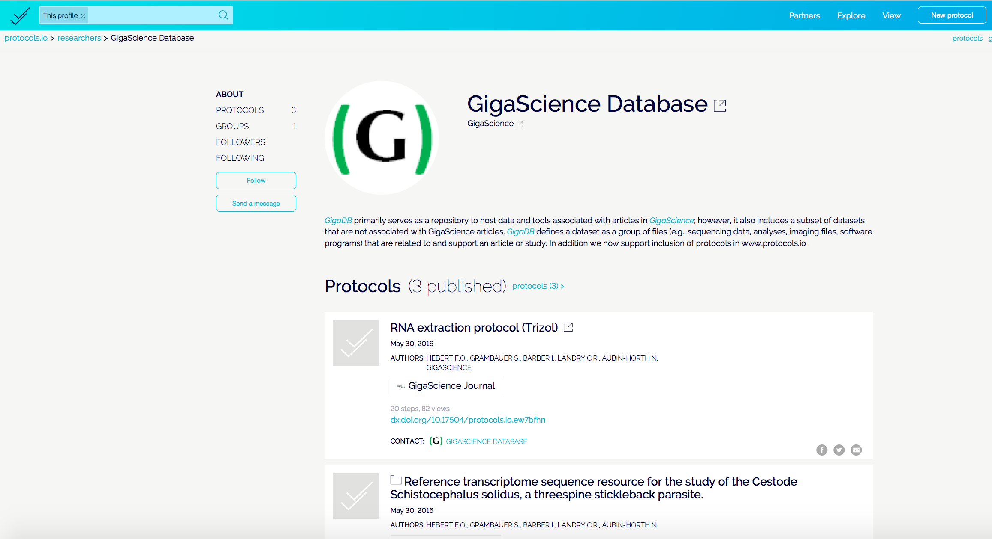
Reward better handling of “wet” protocols…
First journal with deep integration with
Launched 2nd June 2016
Create, share, modify forkeable protocols in repo.
Download & run on smartphone app.
Get discoverability, credit, DOIs for sharing methods.
Create your own, or let us set up & you claim.
http://protocols.io/
Notes:
For example we published the RNA extraction experiment protocol

Slide 14
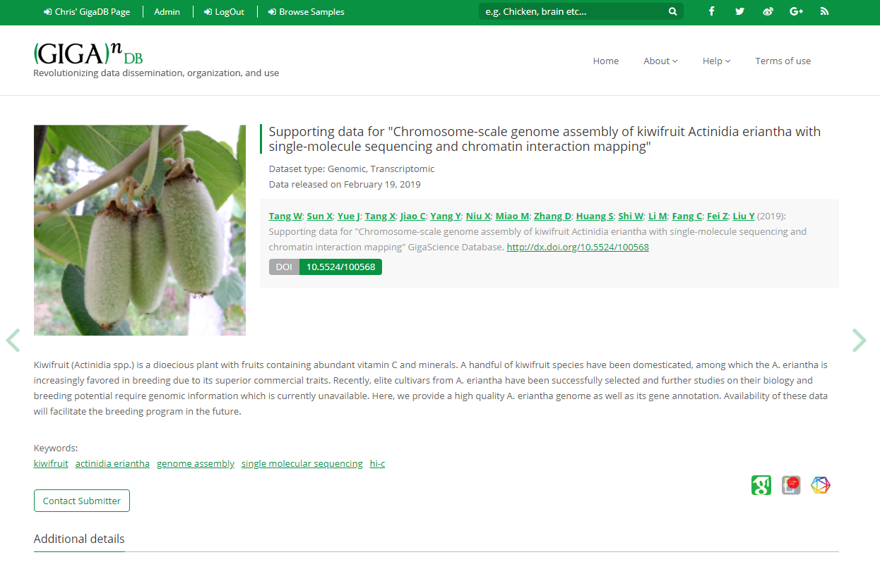
Notes:
Kiwifruit genome dataset

Slide 15
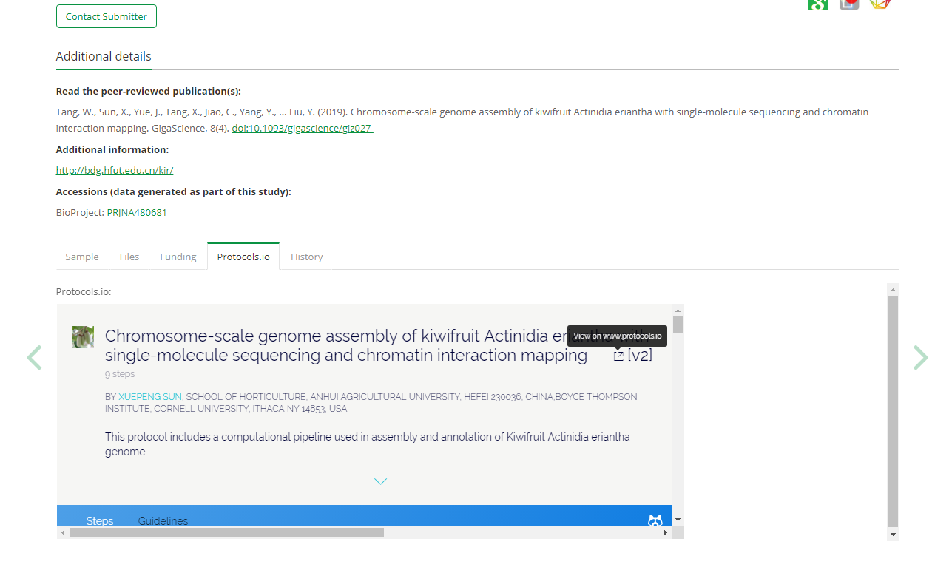
Notes:
We embed the protocol.io widget in the dataset page

Slide 16
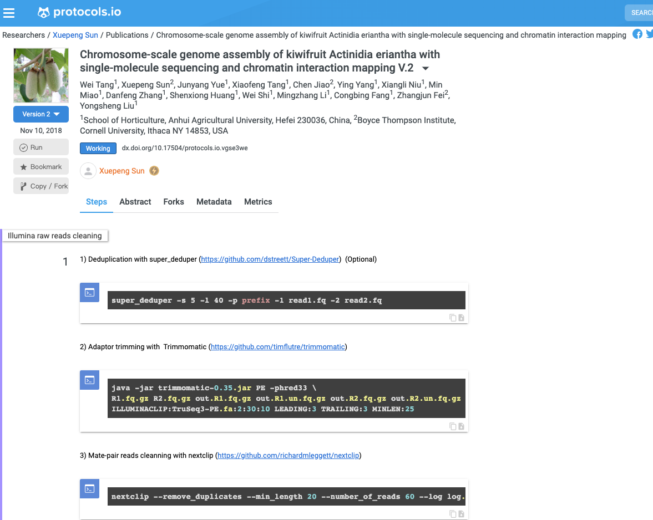
Notes:
The protocol will show users how to reproduce the results. This example is do the illumine raw reads cleaning.

Slide 17
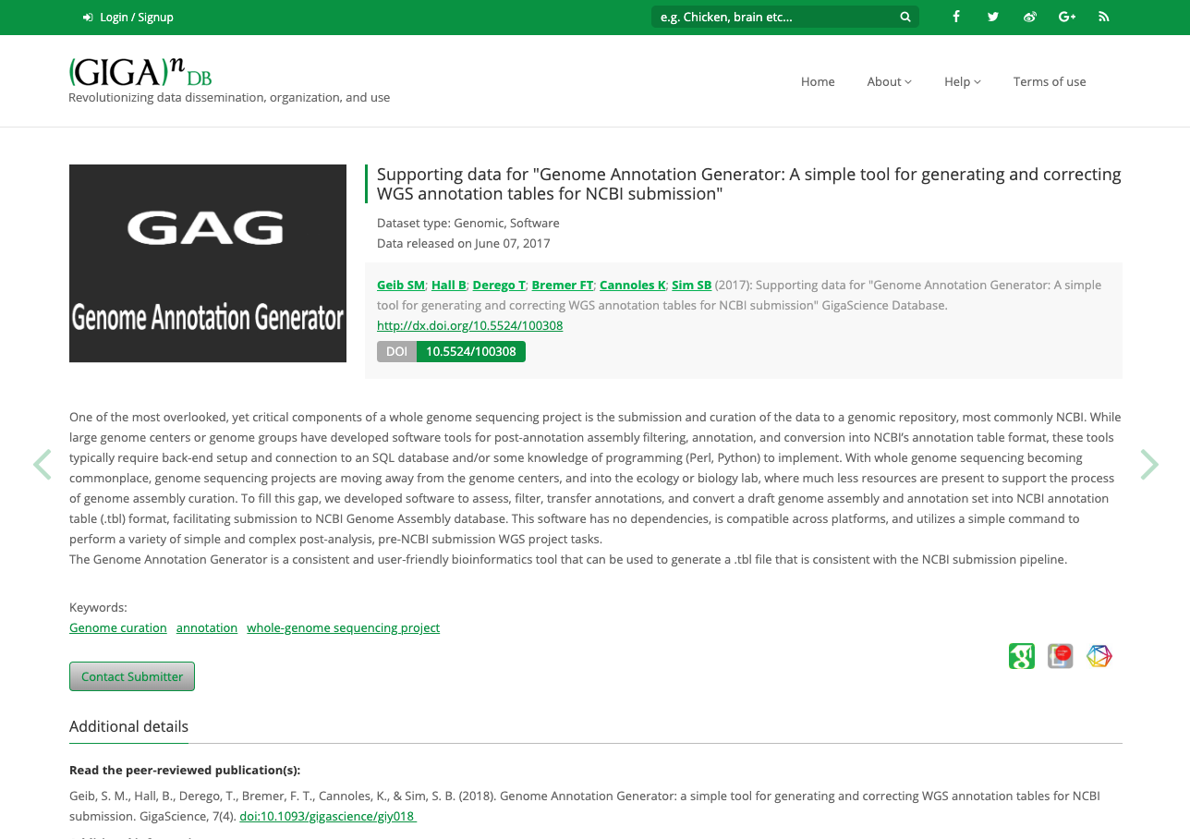
Notes:
For the software dataset, like this dataset, it’s the tool for genome annotation generator

Slide 18
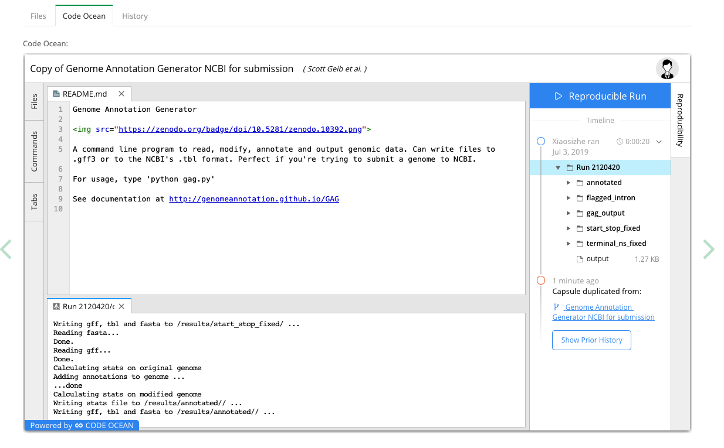
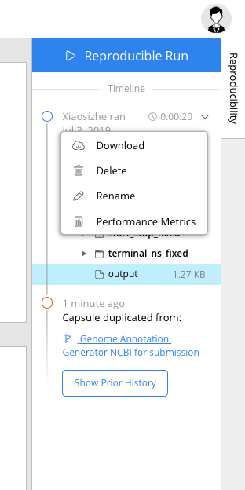
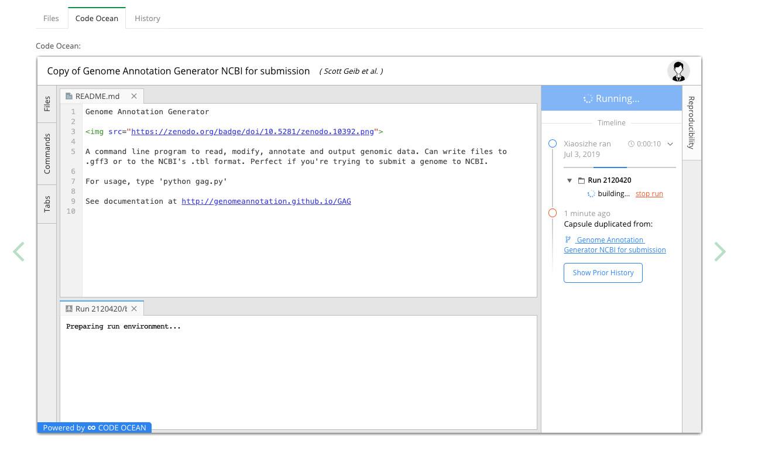
Notes:
On the dataset page, we embed the code ocean widget. Which already implement the software with input files. So users can eaisy run it, just click the button. And get the result file

Slide 19
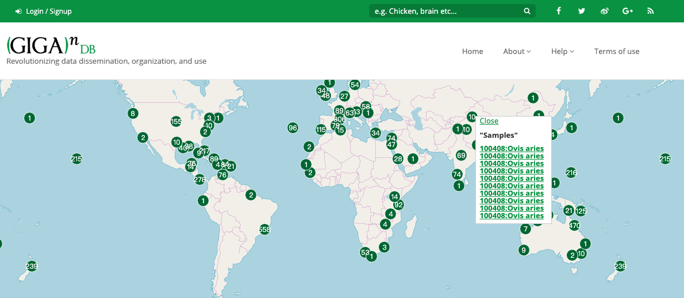
Sample Map Browser
Notes:
We have the sample map browser, user can easily find the sample with the geographic location information

Slide 20
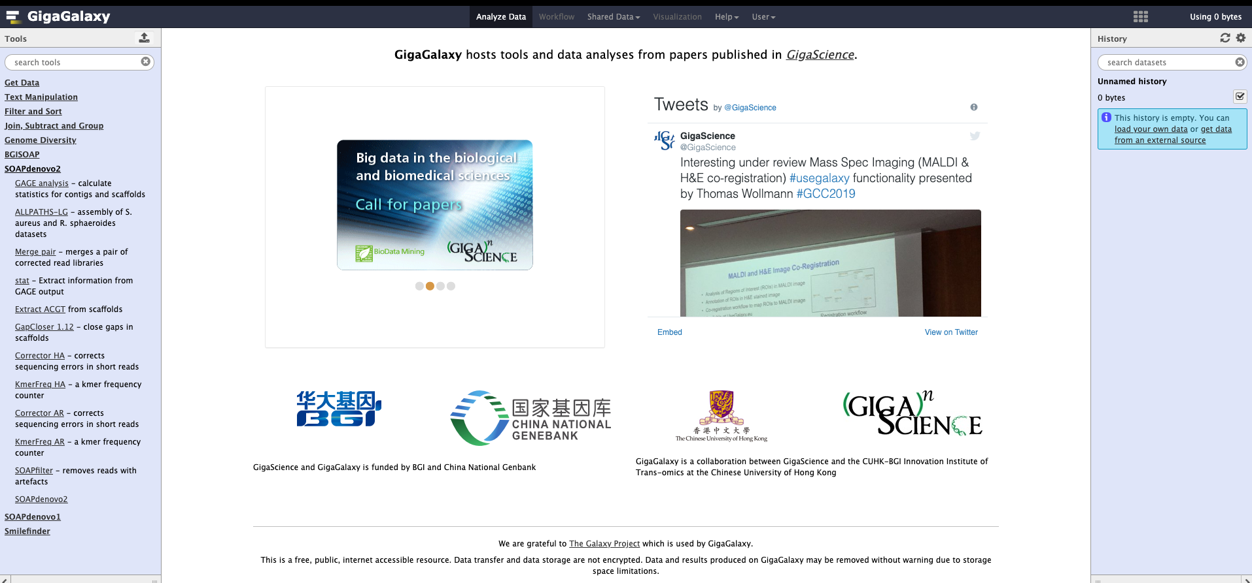
GigaGalaxy Platform

Slide 21
Giga-OMERO
Not released yet
Big image file
average size > 2G
Notes:
缩略图, 缩放比例， 编辑metadata

Slide 22
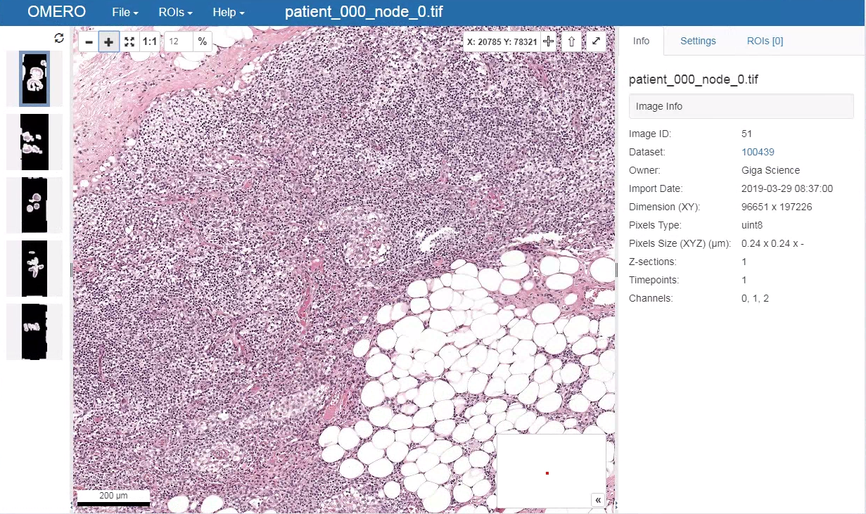
Double-clicking on a thumbnail image opens the OMERO.iviewer zoom viewer in a new window

Slide 23
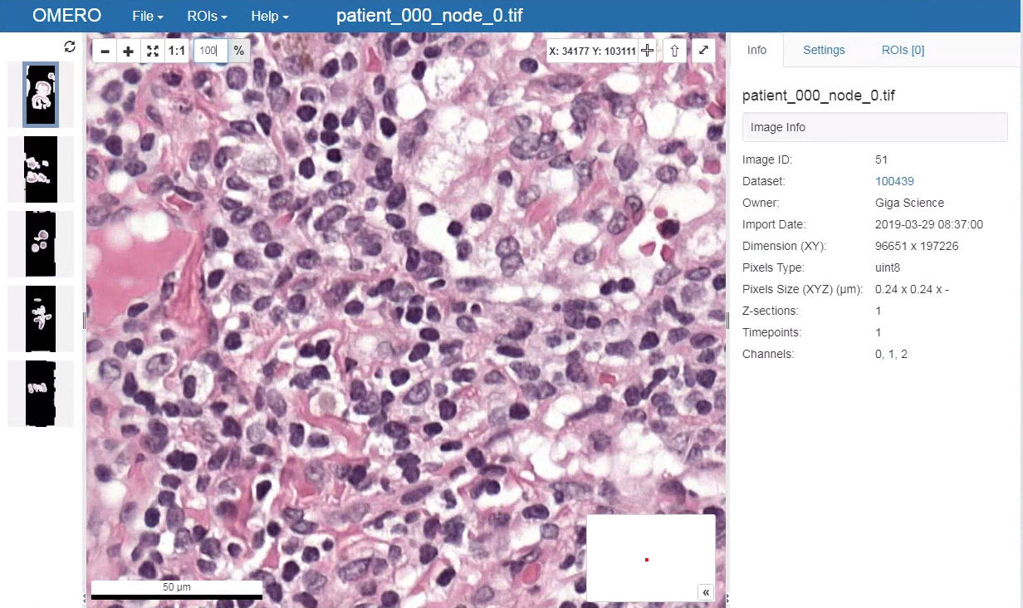
The zoom viewer allows whole-slide images to be explored at cellular resolution in the context of a web browser, and without need for data download.
This example shows a lymph node section from a breast cancer patient.
These data are available at: http://dx.doi.org/10.5524/100439
Notes:
缩放功能, 乳腺癌病人淋巴结部位

Slide 24
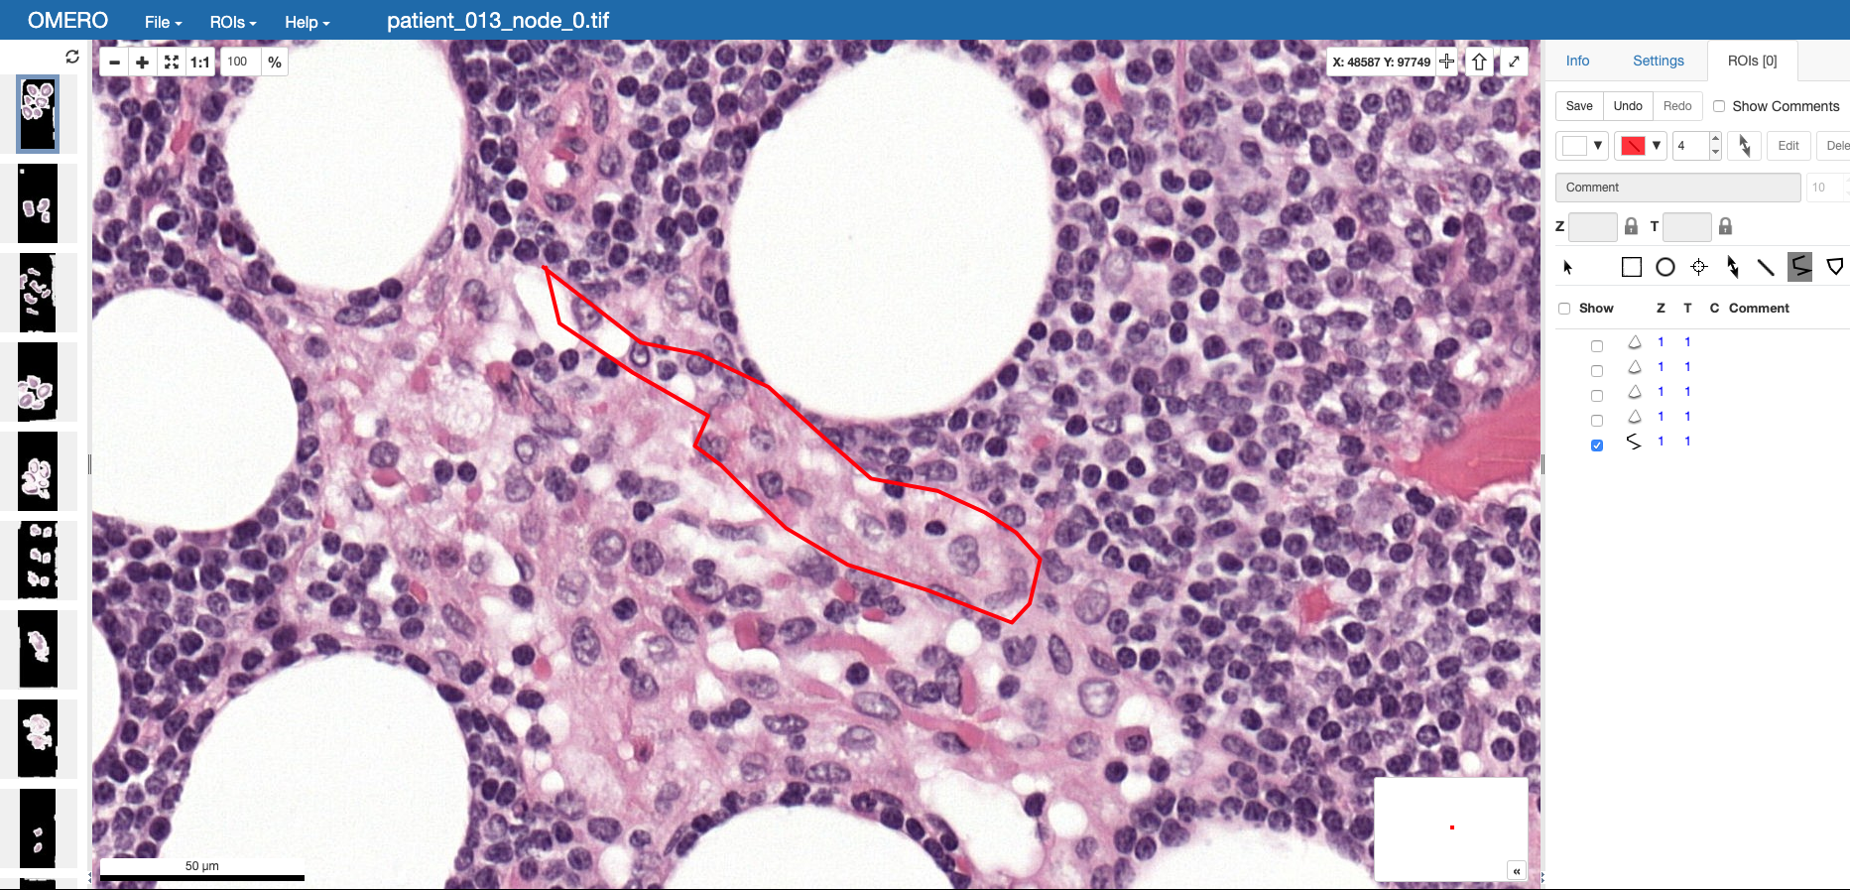
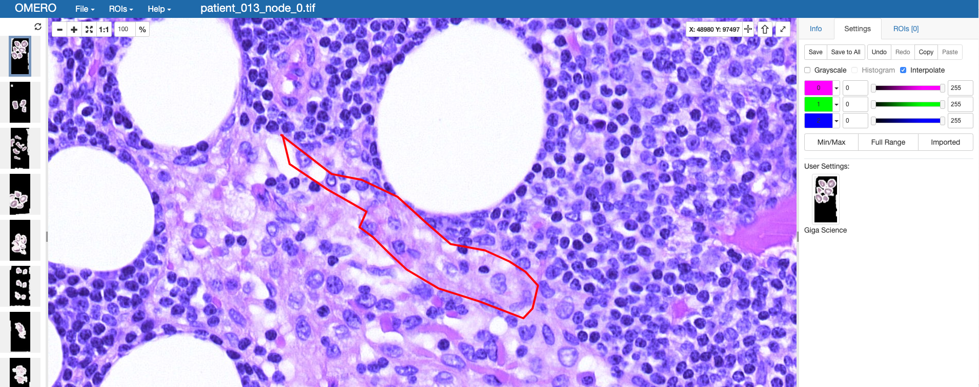
Edit
Comment
Metadata
Coverage

Slide 25
Summary:
Through our scientific data service:
Reduce fraud (by making it easier to see)
Spot errors before publication
More organised data
Credit for data producers
Greater visibility of data
Increased exposure of article
Allows interactive data/results/research
Notes:
Reduce frɔːd
Spot errors before publication, the reviewer and curator can check the data
More organized data with the structured metadata
激励鼓励数据生产者和分享者
增强数据的可视性
更好的展示科学论文，以及增强数据，结论，研究的互动

Slide 26

谢谢

