Slide 1
Towards Next-Gen Media Library :
a small step

Slide 2


Slide 3
Outline
Searchable subtitles
Streaming strategy

Slide 4
Searchable Subtitles

Slide 5
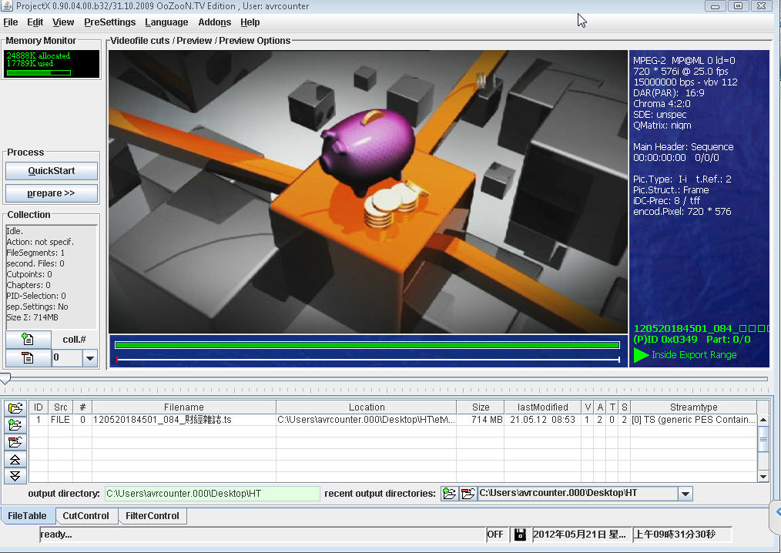

Slide 6
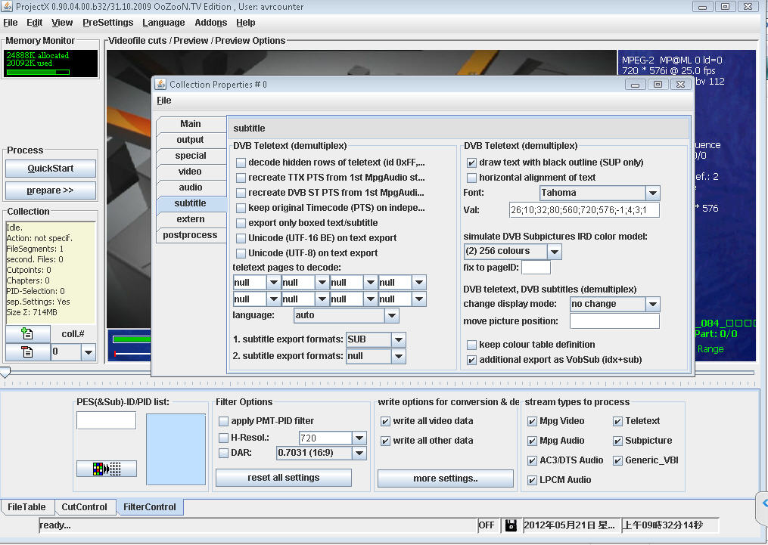

Slide 7
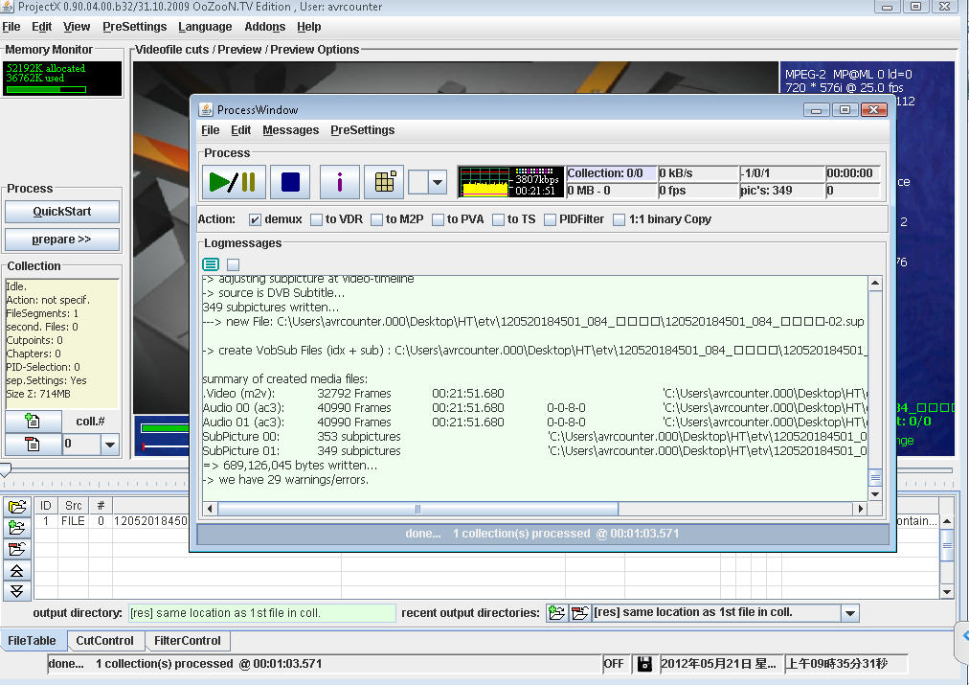

Slide 8
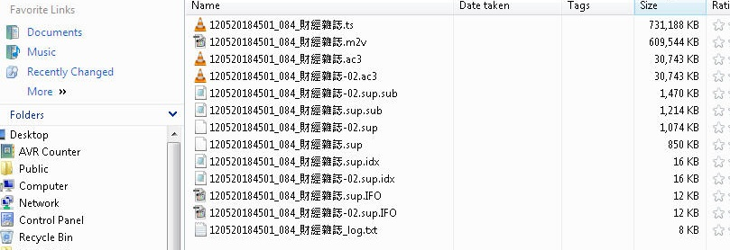

Slide 9
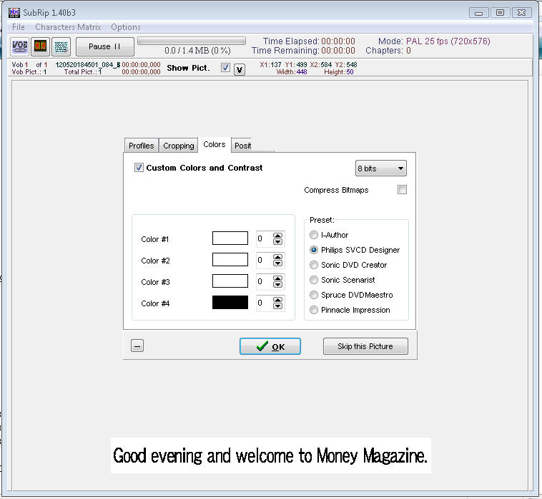

Slide 10
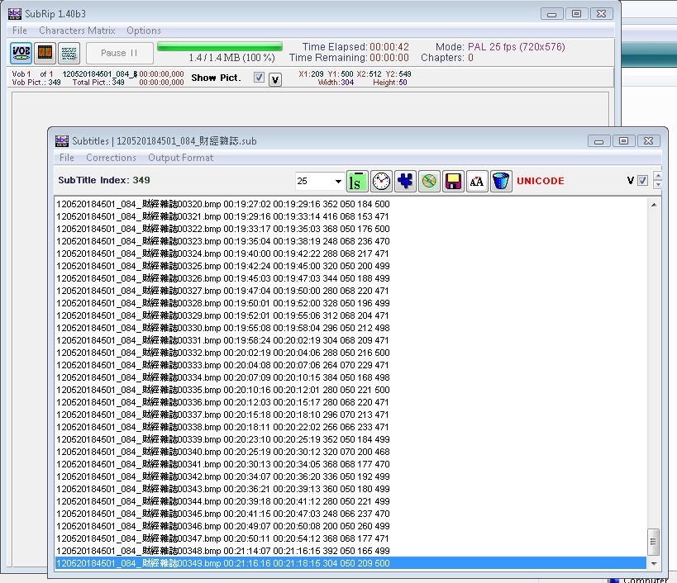
Start time & End time

Slide 11
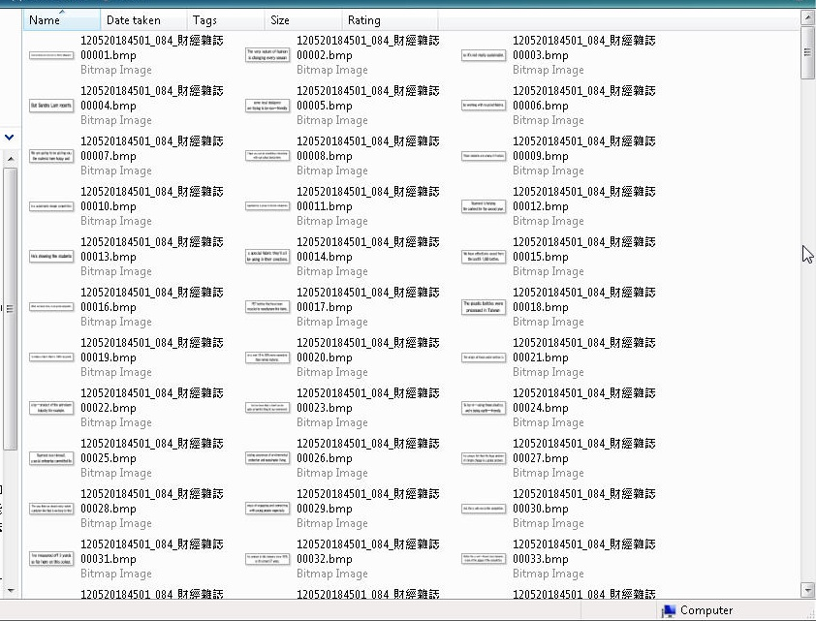

Slide 12
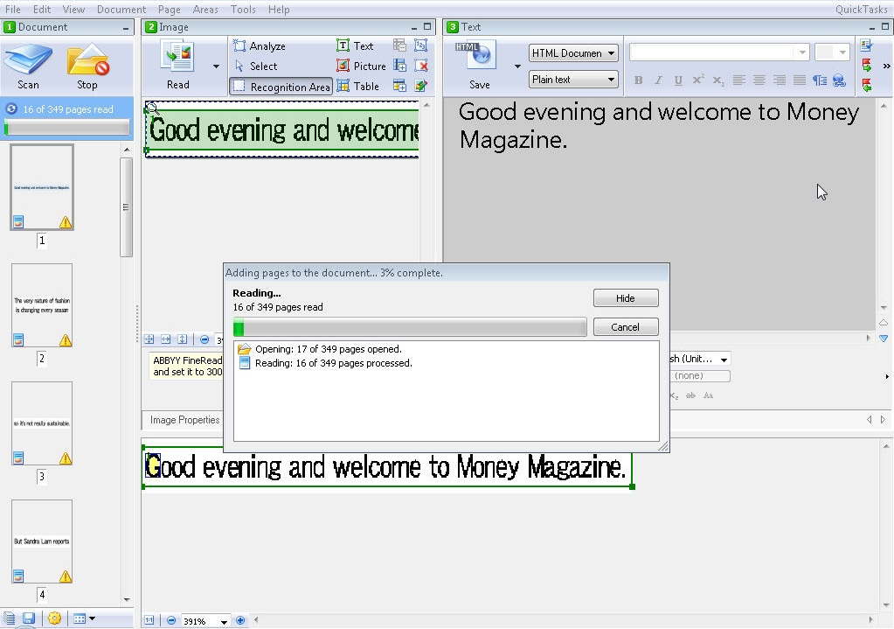

Slide 13
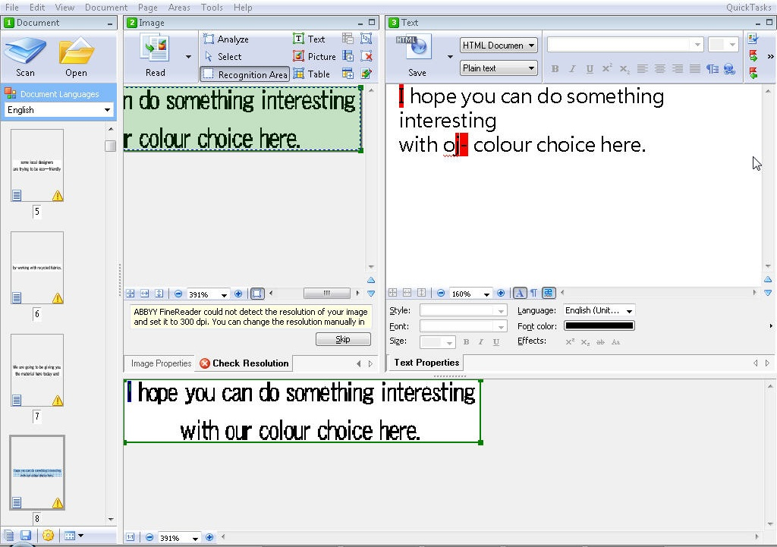

Slide 14
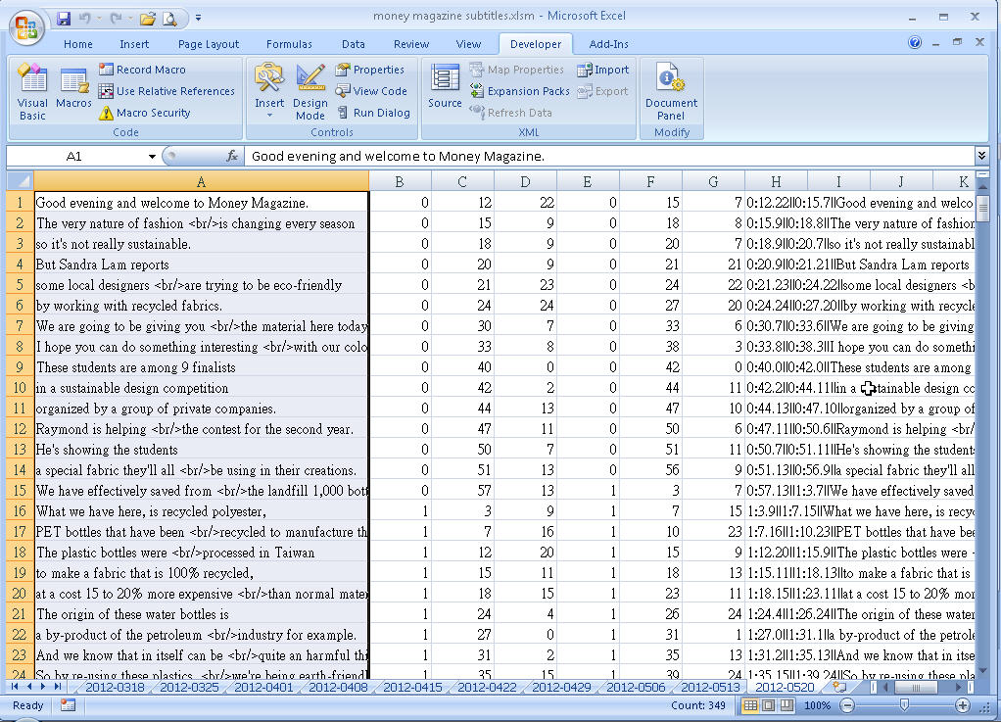

Slide 15
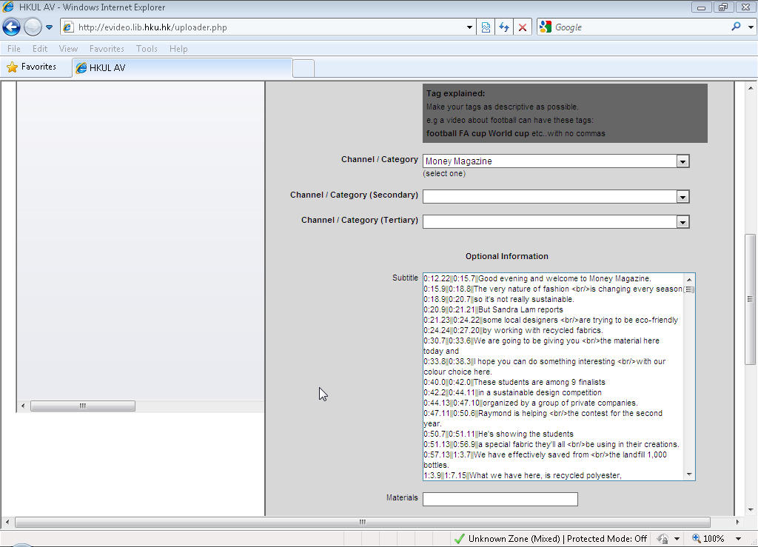

Slide 16
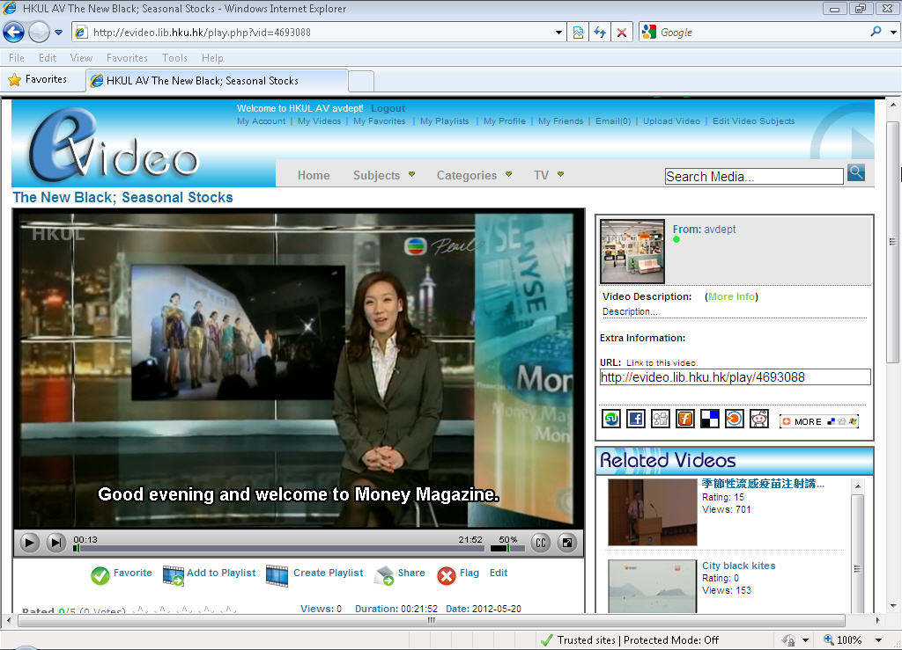
Solr Search Engine

Slide 17
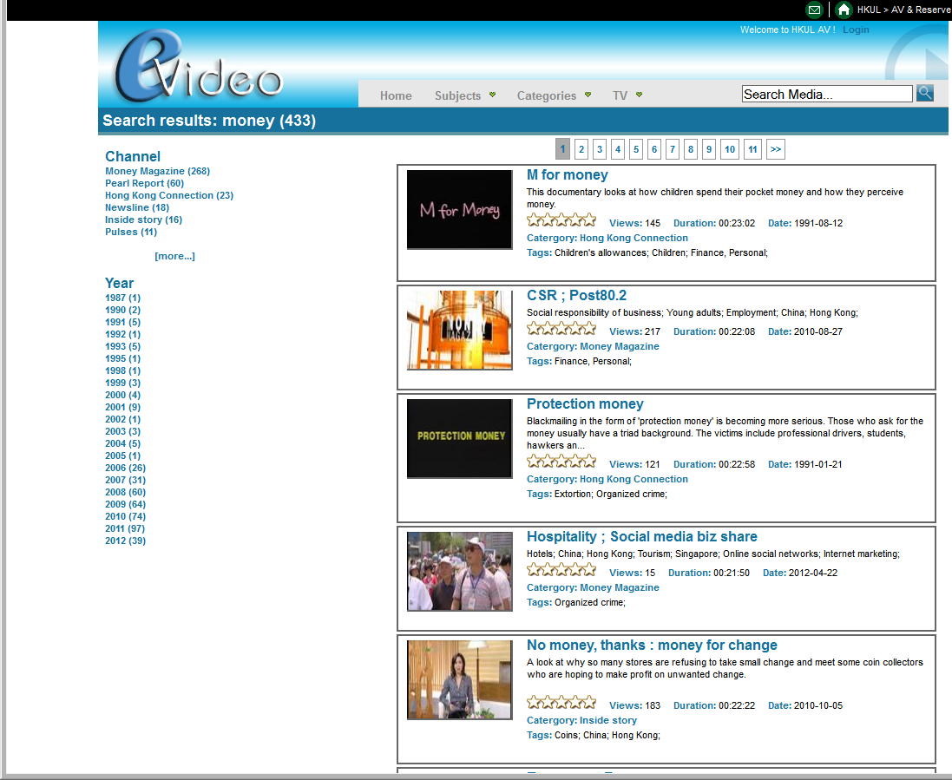
Faceted Search

Slide 18
Streaming strategy

Slide 19
E-video collection
Buy/Ask perpetual Streaming license for non-movie, such as
  Phoenix TV
  Content publisher / author
  HKU events
  etc.
  Shaw’s Bros movie trailer collection

Slide 20
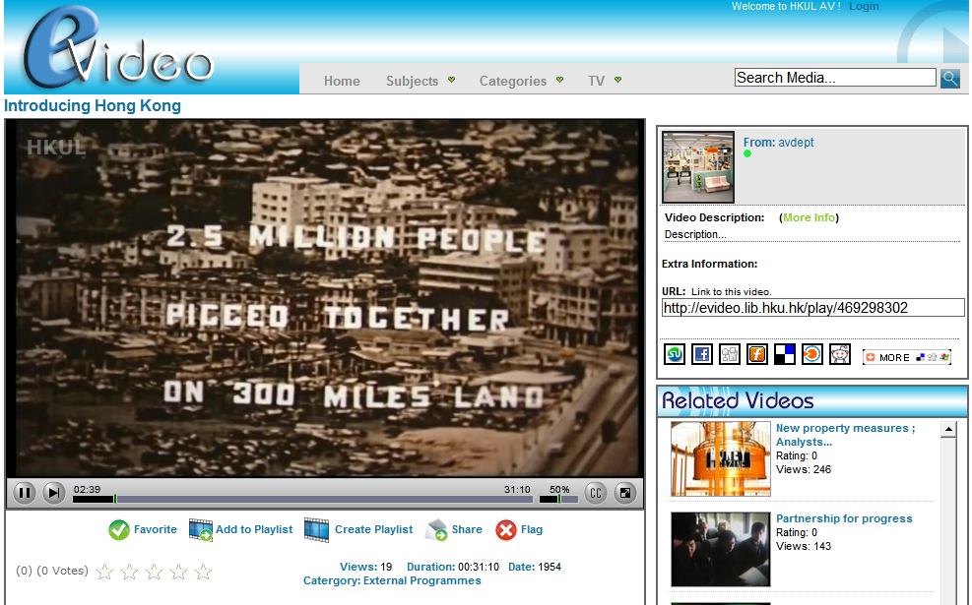
http://evideo.lib.hku.hk/play/469298302

Slide 21
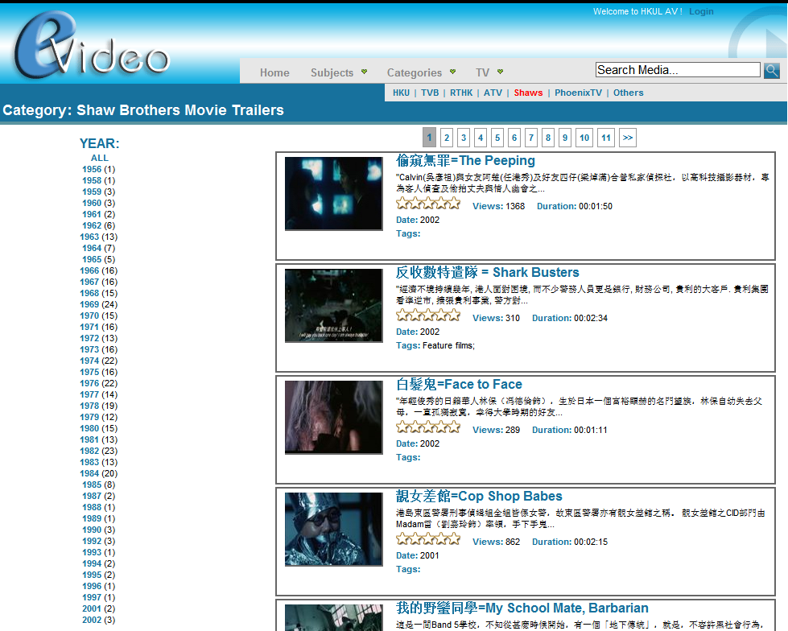
http://evideo.lib.hku.hk/category_home.php?cid=108

Slide 22
Commercial Contents?
What about commercial movies and music?
Universal Gramophone, Linn replied: “NO; thinking ; let’s talk ”

Slide 23
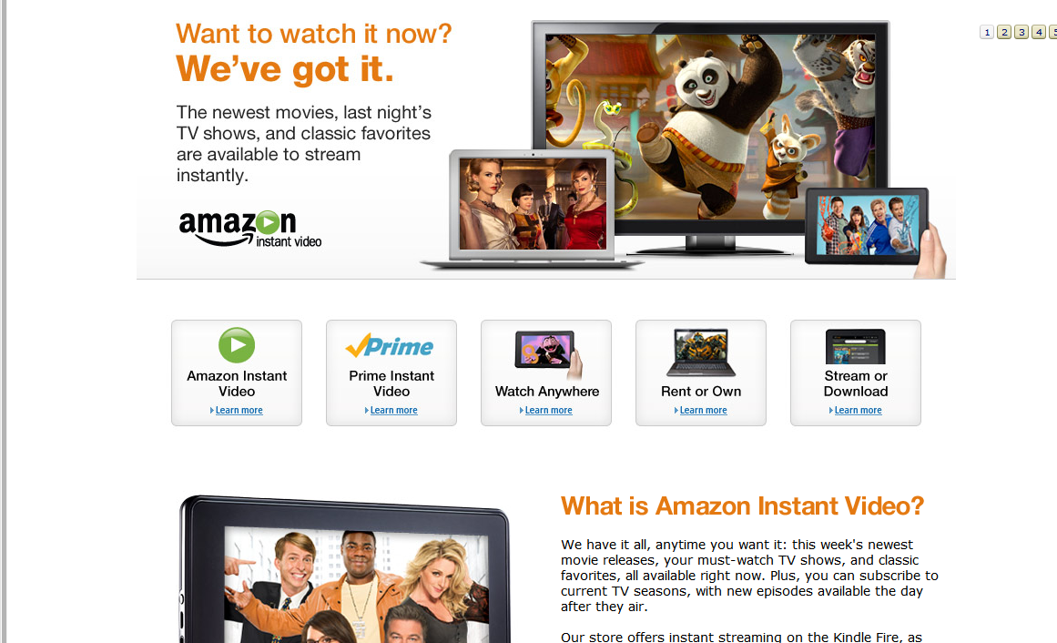

Slide 24
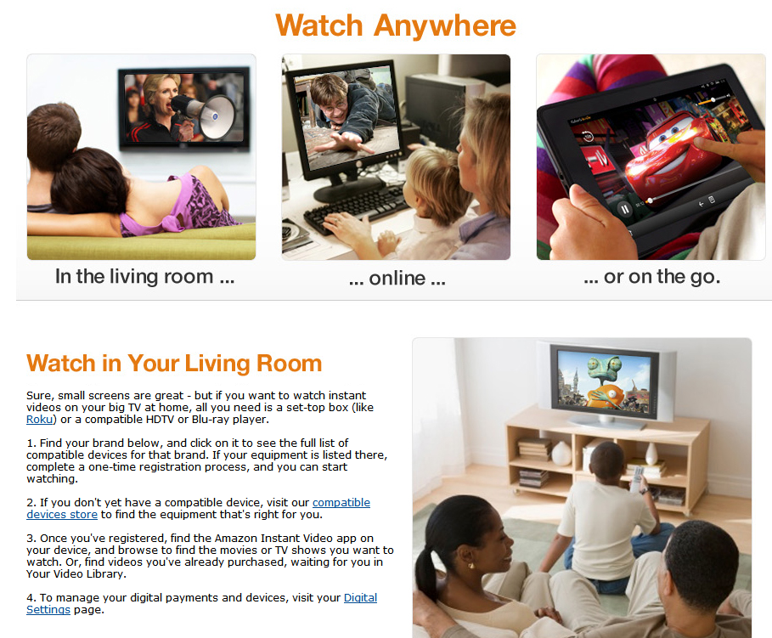

Slide 25
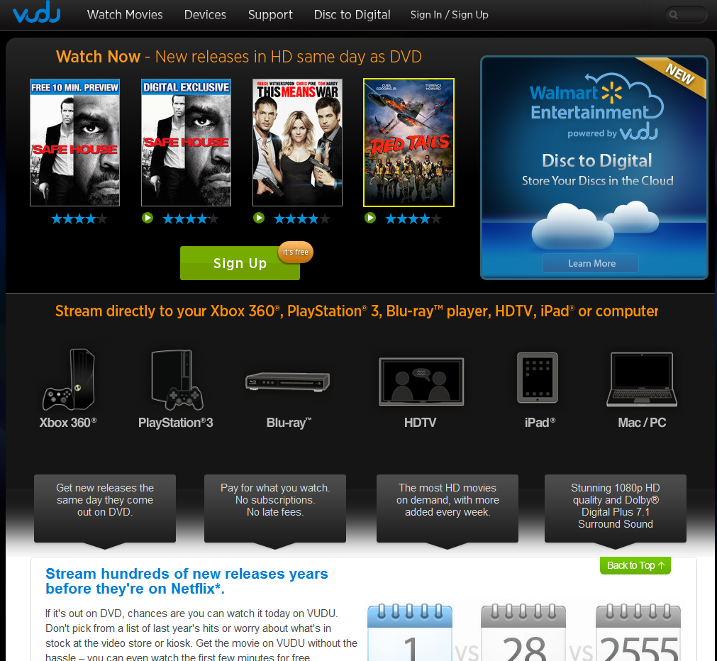

Slide 26
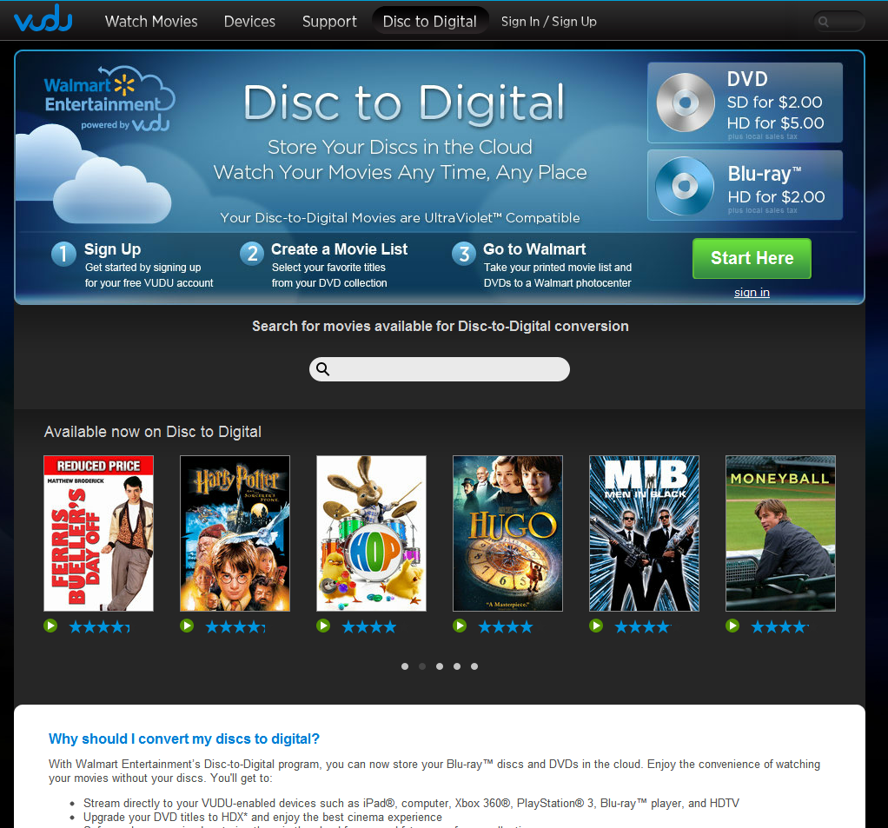

Slide 27
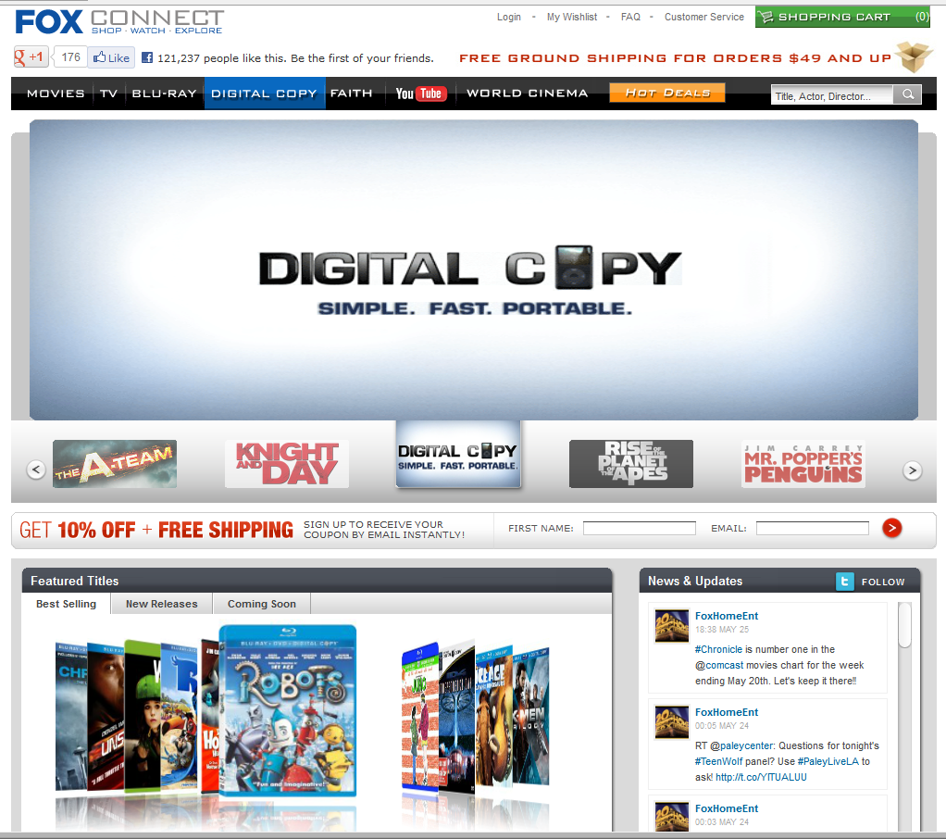

Slide 28


Slide 29



Music Online
Name of platform | Subscription | Access |  | Ringtone MV | Others | Enquiry Feedback
 | Information from web | Devices | Add-ons application
3Music | HK$9 per song | Mobile phone (download is a must) |  | B |  | No reply
EOLasia.com | HK$8 per song | Any digital devices (download is a must) | Windows Media Player | B |  | No reply
KKBox | HK$40/month | PC / MAC / Smart phone / Tablet (streaming & D/L is ok) | KKBOX | O | It can set up own radio to share songs | Service updating, technical support & price reply later
Moov | HK$49/month | PC / MAC / iPhone Required Adobe Flash Player 10+ (streaming & D/L is ok) | O | MV only |  | Distribute login ID & password Fixed station to access Price reply later
Music One | HK$88/month | PC / MAC / iPhone Required Adobe Flash Player 9+ (streaming only) | O | MV only | Limited to HKBN customers only | Subscription fee for 100+ can negotiate
Musicholic | HK$48/month | PC / MAC / iPhone / iPad (streaming & D/L is ok) | O | MV only |  | Technical problem about multi-user
MusicXS | New subscription service is not available since Feb 2011
Soliton-music | HK$49/month | PC / MAC / Smart phone / Tablet (streaming & D/L is ok) | SOLITON DESKTOP APP V1.07 | O |  | Same as information from their homepage

Slide 30
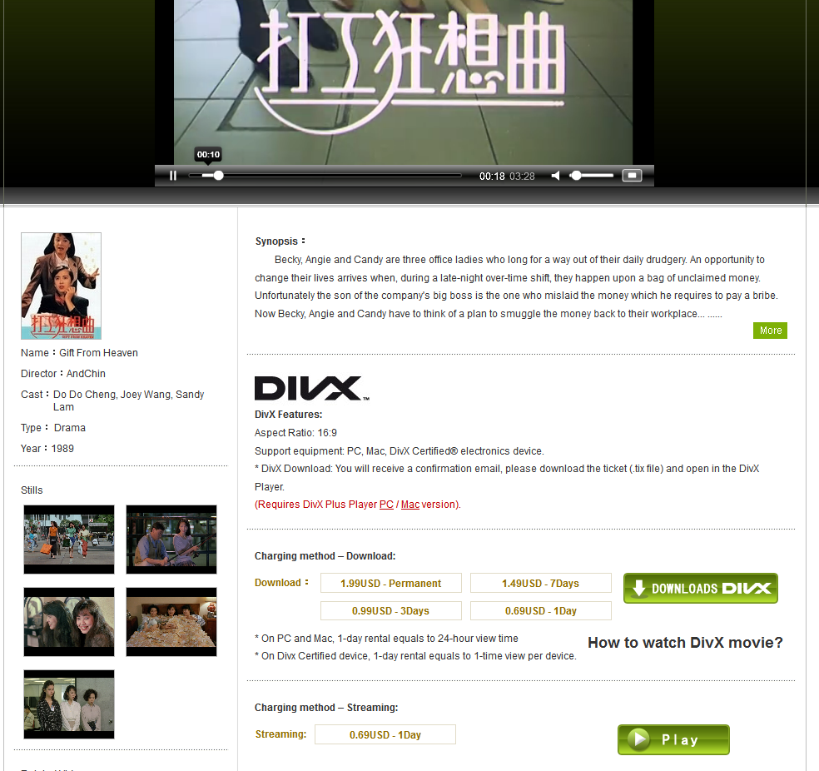

Slide 31
DEMO

Slide 32
Issues worth discussing
The digital file / streaming is for personal use .
Publishers are not familiar with library environment & their business model deals with ‘single entity’ only .
There are many ‘publishers’. We can hardly talk to them one by one to deal with streaming license.
Revise Copyright law ?
Can a task force be setup to deal with streaming license?

Slide 33
So..
We have the technologies.
  and
We need streaming contents ..

Slide 34
Monitor List
Apple TV
Netflix
Tivo
Vudu
[more…]

Slide 35
The End.

